Slide 1
Python for Everyday Life
Claudio Sparpaglione

Slide 2
Claudio Sparpaglione
Software Architect
(previously: CTO, developer)
8+ years Pythonista with experience in designing and coding web-scale systems and APIs
Open source advocate & maintainer
@csparpa
csparpa.github.io

Slide 3
The Course Overview

Slide 4
Python for Everyday Life course overview
1
Programmers
Tooling
5
Handle
common
file formats
7
Interacting
with websites
9
Automate common
Internet tasks
13
Publish your CV
as an API
on Django
15
Datasets manipulation & visualization with Jupyter & Pandas
3
Advanced
Python
topics
11
Build a static website with
Flask &
Bootstrap
4
Manipulate
files & folders
8
The power
of APIs
12
Python & databases
2
Finding the
right tool
for the job
6
Processing
images
10
Anatomy of
a web app
14
A Facebook messenger bot based on Flask & Heroku
16
Getting insights from your datasets

Slide 5
Prerequisites &
Tooling
Notes:
Something that needs to grab the viewers attention!!

Slide 6
Prerequisites
Tooling
Basic programming experience
Exposure to the basics of the Python programming language
What you need to know
Min HW: Dual Core 3.0 Ghz, 4GB memory, 500 MB free disk space
OS: Windows, Linux, MacOS
SW:
Python 3.5+ interpreter installed
A modern web browser (eg. Chrome or Firefox)
What you need to have

Slide 7
Course Goals
Notes:
Something that needs to grab the viewers attention!!

Slide 8
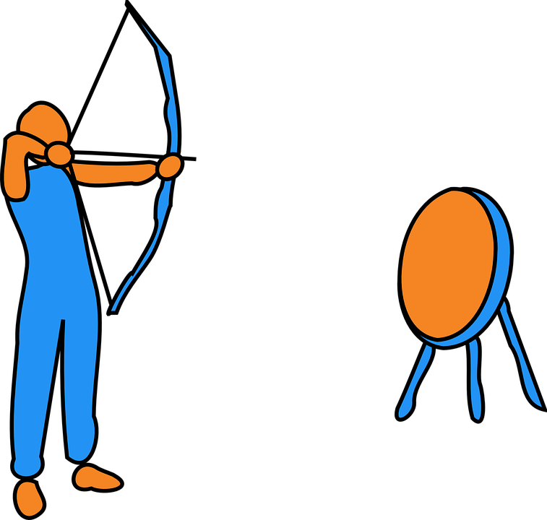
Course Goals
By the end of this course you will have learned how to:
write code proficiently and in a structured fashion
tackle coding problems by crafting tailored solutions or applying suitable pattern/tools
manipulate and visualize data as a support to take informed decisions
implement a wide range of applications to handle common everyday life tasks
Notes:
[Mandatory Slide]
Before the start of the video, we’d like to highlight what are important topics or pointers that we’d be covering in this video. This slide would immediately follow the intro/name slide. This would just be say 2-3 points for the viewers to know what they are getting into.

Slide 9
Why should I take this course?
Notes:
Something that needs to grab the viewers attention!!

Slide 10

Why should I take this course?
Because life is incredibly beautiful and infamously short!
There is no point in wasting time doing boring tasks that can be automated
Therefore the algorithm is simple:
Take this course
Automate as much as you can
Enjoy your life!
Notes:
[Mandatory Slide]
Before the start of the video, we’d like to highlight what are important topics or pointers that we’d be covering in this video. This slide would immediately follow the intro/name slide. This would just be say 2-3 points for the viewers to know what they are getting into.

